Slide 1
Member institutions accessing reports created in the network zone institution
Yoel Kortick – Senior Librarian

Slide 2
  Introduction
  The functionality
  The functionality from Fulfillment Jobs Configuration
  Let's see it live

Slide 3


Introduction

Slide 4
Introduction
This functionality relates specifically to network zone consortia.
A network zone consortia consists of one institution which is the "network zone" as well as additional institutions which are the "member institutions"
A sample of such a setup is on the next slide, where there are three member institutions:
Alma University
Open University
University of Knowledge

Slide 5

Demo Environment Network Zone Consortia
Network Zone institution
Member institution
‘Alma University’
Member institution
‘Open University’
Member institution
‘University of Knowledge’

Slide 6

The functionality

Slide 7
The functionality
The functionality described here is as follows:
The network zone creates Alma Analytics reports and saves them in the network zone folder
Member institutions access the reports from the network zone while logged into their own member institution
When the member institution runs the report from the network zone it runs on their own data (the data of their own member institution) even though the report is being taken from the network zone

Slide 8
The functionality
This functionality is advantageous because:
The network zone can create a series of reports which can be used by all the members
The various members can then run identical reports in their institutions.
One person or group of people can create the reports, and all (or some) members can use them.

Slide 9
The functionality
Without this feature reports would need to be either created separately in each institution or created in the community folder and then shared.
The disadvantage of doing this via the community folder is that the community folder is not "protected" from any other user editing (or even deleting) the reports.
With the functionality described here, because the reports are made in the network zone folder there is full privacy.
While the member institutions can see and use the reports from the network zone, they cannot edit them.

Slide 10

The configuration

Slide 11
The configuration
To enable this functionality a parameter must be set in both the network zone institution and the member institution.
The network zone institution states: "I am allowing the members to see me".
The member institutions state: "I am allowing myself to see the network".

Slide 12
The configuration
The following parameters should be set to true:
In the Network zone: analytics_catalog_available_for_members
  Located at "Configuration > Analytics > Analytics Network Settings"
In the member: analytics_catalog_available_for_my_institution
  Located at "Configuration > Analytics > Analytics Member Settings"
When both parameters are set to true, the Network Zone report folder is visible to the member institution, which can access the reports as read-only.

Slide 13
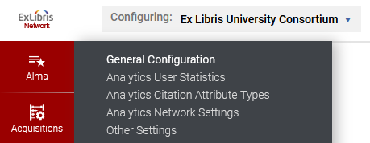

The configuration
In the network

Slide 14
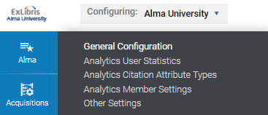

The configuration
In the member

Slide 15

Let's see it live

Slide 16
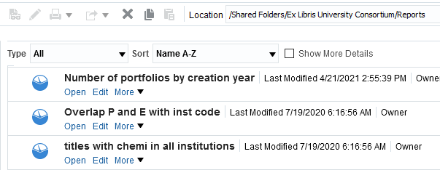
Let's see it live
In the network zone there is a report called "Number of portfolios by creation year" in folder "/Shared Folders/Ex Libris University Consortium/Reports"

Slide 17
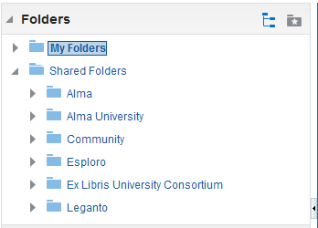
Let's see it live
In the member institution we can see the folder from the network zone
We are logged into member Alma University
We see the folder from the network zone

Slide 18
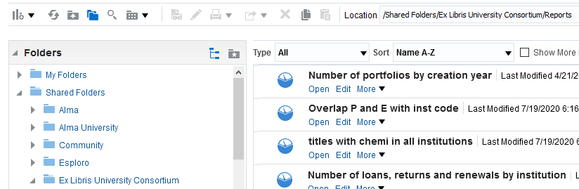
Let's see it live
In the member institution we can see the report which we saw while logged into the network zone

Slide 19
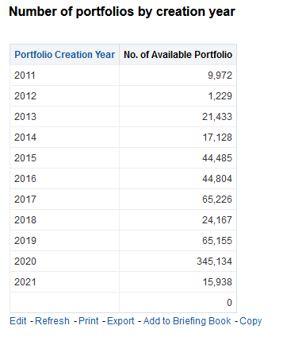
Let's see it live
In the member institution we can run the report from the network zone and it is done on the data of the member institution

Slide 20
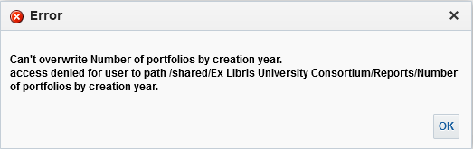
Let's see it live
In the member institution users cannot edit or delete the reports from the network zone folder. It is “read only”.

Slide 21
xxx@exlibrisgroup.com

